Slide 1
Data Structures(IT28008)
Mukesh Sakle
Assistant Professor
Department of Information Technology

Slide 2
Introduction
Data structures: A data structure is a way of organizing data that considers not only the items stored, but also their relationship to each other
Linear data structure: A linear data structure traverses the data elements sequentially, in which only one data element can directly be reached.

Slide 3
Stack : Linear data structure
DATA STRUCTURE
LINEAR DATA STRUCTURE
ARRAY
QUEUE
NON LINEAR DATA STRUCTURE
STACK

Slide 4
Stack
Stack is the Last In First Out, (LIFO) data structure, where the element inserted last is the first to come out of the stack
Anything added to the stack goes on the “top” of the stack
Anything removed from the stack is taken from the “top” of the stack
Things are removed in the reverse order from that in which they were inserted

Slide 5

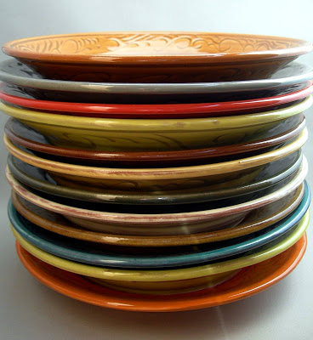
Examples of stack
Stack of books
Stakes of plates

Slide 6
Operations on stack
Push: Adds the element to the top of the stack
Pop: Removes the element from the top of the stack
Peek: Returns the top element of the stack
IsEmpty: Returns True if Stack is empty
IsFull: Returns True if Stack is full

Slide 7
A LIFO Stack
Push
Pop
Stack Pointer
Top
Bottom

Slide 8
Push Operation
Function: Adds new-Item to the top of the stack.
Preconditions: Stack has been initialized and is not full.
Postconditions: new-Item is at the top of the stack.

Slide 9
Algorithms of Push operation on stack
Push(stack, Top, MAXSTK, X)
Step1: [stack already filled? ]
If Top = MAXSTK - 1 then: Print “overflow” and return
Step 2: set Top = Top + 1 [increase top by 1]
Step 3: set Stack[Top] = x [insert X in new Top position]
Step 4: Return
Here, MAXSTK is max size of stack[] array
X = element to be inserted in stack
Top: contains the location of topmost element in stack

Slide 10
Push Operations
Push (10)
Stack is full, so
“Overflow occurs”
Push (20)
50
4
40
Push (30)
3
30
2
Push (40)
20
1
Push (50)
10
0
Top
-1
Push (60)

Slide 11
Overflow in stack
Overflow: when stack is full, no more elements are to be added, the status of stack is called overflowed
For ex→ MAXSTK: contains the maximum number of elements held by stack
If (top = = MAXSTK - 1)
then print “overflow”

Slide 12
POP ()
Function: Removes top-Item from stack
Preconditions: Stack has been initialized and is not empty.
Postconditions: Top element has been removed from stack

Slide 13
Algorithms of Pop operation on stack
Pop(stack, Top, X)
Step1: [stack has an element to be removed? ]
If Top==-1 then: Print “underflow” and return
Step 2: set x = Stack[Top] [Assign Top element to x]
Step 2: set Top = Top - 1 [decrease top by 1]
Step 4: Return

Slide 14
POP OPERATIONS
Pop ()
Top
Pop ()
50
4
40
Pop ()
3
30
Pop ()
2
20
1
Pop ()
10
0
Pop ()
Stack is empty, so
“underflow occurs”
-1

Slide 15
Underflow in stack
Underflow: when stack is empty, no more elements are be deleted, the status of stack is called underflow.
For ex: If (Top == -1)
then print “underflow”

Slide 16
Applications of stack
Recursion
Handling the order of function calls
Evaluation of postfix expression
Reverse the string
Checking for balanced braces
Transformation of infix expression postfix expression

Slide 17
Recursion
The function which call itself (In function body ) again and again, as long as base condition is satisfied, is known as recursive function.
Factorial function using recursion
int fact(int n)
{
if(n==1) // base case
{
return 1;
}
else
{
return( n * fact(n-1) );
// recursive case
}
}

Slide 18
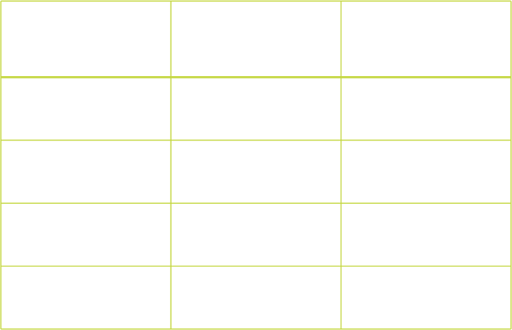
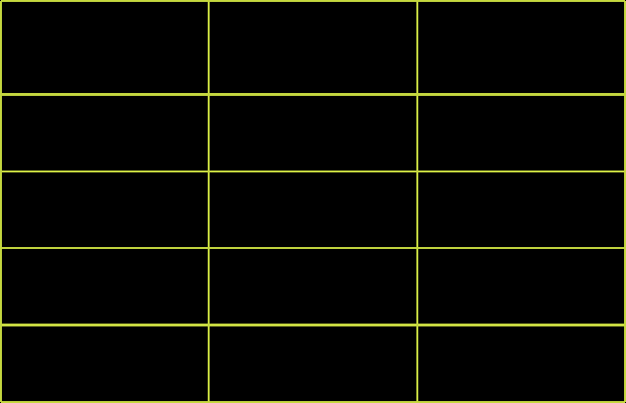
Stack frame: factorial function
n = 1 n = 2 | 1 2 * fact(1) | 2 * 1 = 2
n = 3 | 3 * fact(2) | 3 * 2 = 6
n = 4 | 4 * fact(3) | 4 * 6 = 24
n = 5 | 5 * fact(4) | 5 * 24 = 120

Slide 19
Handling the order of function calls
Void three()
{
printf(“three started \n”);
printf(“three ended \n”);
}
Void two()
{
printf(“two started \n”);
three();
printf(“two ended \n”);
}
Void one()
{
printf(“one started \n”);
two();
printf(“one ended \n”)
}
Void main()
{
printf(“main started \n”);
one();
printf(“main ended \n”);
}

Slide 20
Stack frame for maintaining the order of function call
Output of program:
Printf(“three started \n”);
Printf(“ three ended \n”);
main started
three()
Printf(“two started \n”);
three();
Printf(“two ended \n”);
one started
two()
two started
three started
one()
Printf(“one started \n”)
two();
Printf(“one ended \n”);
three ended
two ended
main()
one ended
Printf(“main started \n”)
one();
Printf(“main ended \n”);
main ended

Slide 21
Evaluation of postfix expression
Step-1 Read the postfix expression from left to right
Step-2 If element is “operand” than
i. Push the element in the stack
Step-3 If element is “operator” then
i. Pop two operands from the stack
ii. Evaluate the expression formed by the two operands and the
operator
iii. Push the results of the expression in the stack end.
Step-4 If “no more elements” then
POP the result
else goto step1

Slide 22
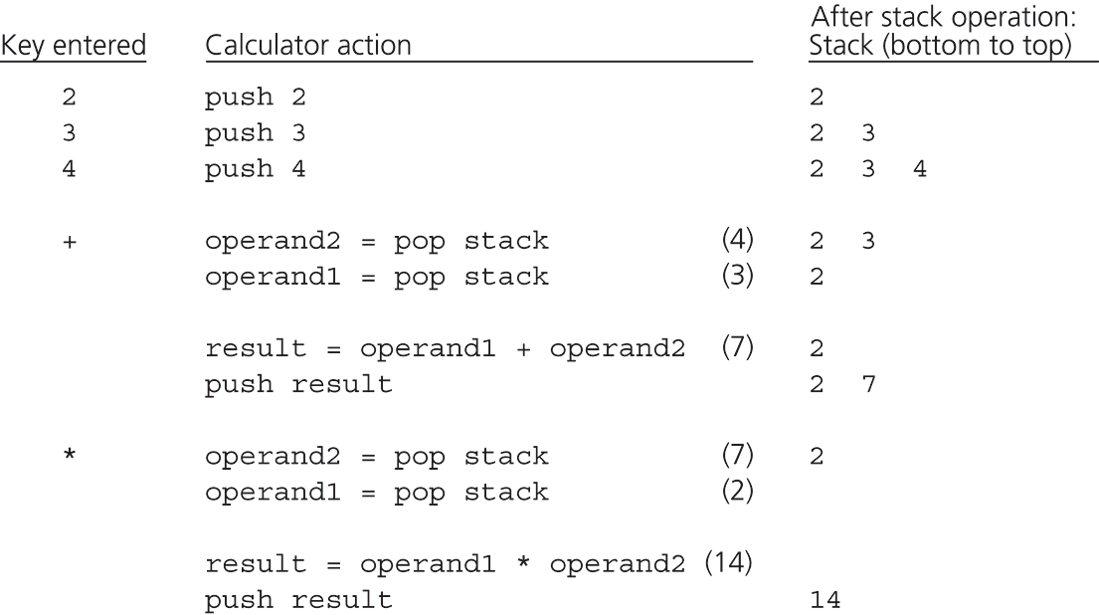
The action of a postfix calculator when evaluating
Postfix Notation: 2 3 4 + *

Slide 23
Reverse the string
We can accomplish this task by pushing each character or member from the string in the order it appears
When the line is finished, characters are then popped off from the stack
“They come off in a reverse order”

Slide 24

Reverse string- name=ANGEL
L E G
N A
E G
N A
P U S H
G N A
N A
A
E G
N A
Name : “L”
P O P
G N A
Name : “LE”
N A
Name : “LEG”
A
Name : “LEGN”
Name : “LEGNA”

Slide 25
Checking for balanced braces
For ex: ([]({()}[()])) is balanced; ([]({()}[())]) is not
Simple counting is not enough to check balance
You can do it with a stack: going left to right,
    Step1: If you see a ”opening bracket” ( i.e. (, [, or { ), push it on the stack
    Step2: If you see a ”closing bracket” ( i.e. ), ], or } ), pop the stack and check whether you got the corresponding (, [, or {
    Step3: When you reach the end, check the status of stack

Slide 26
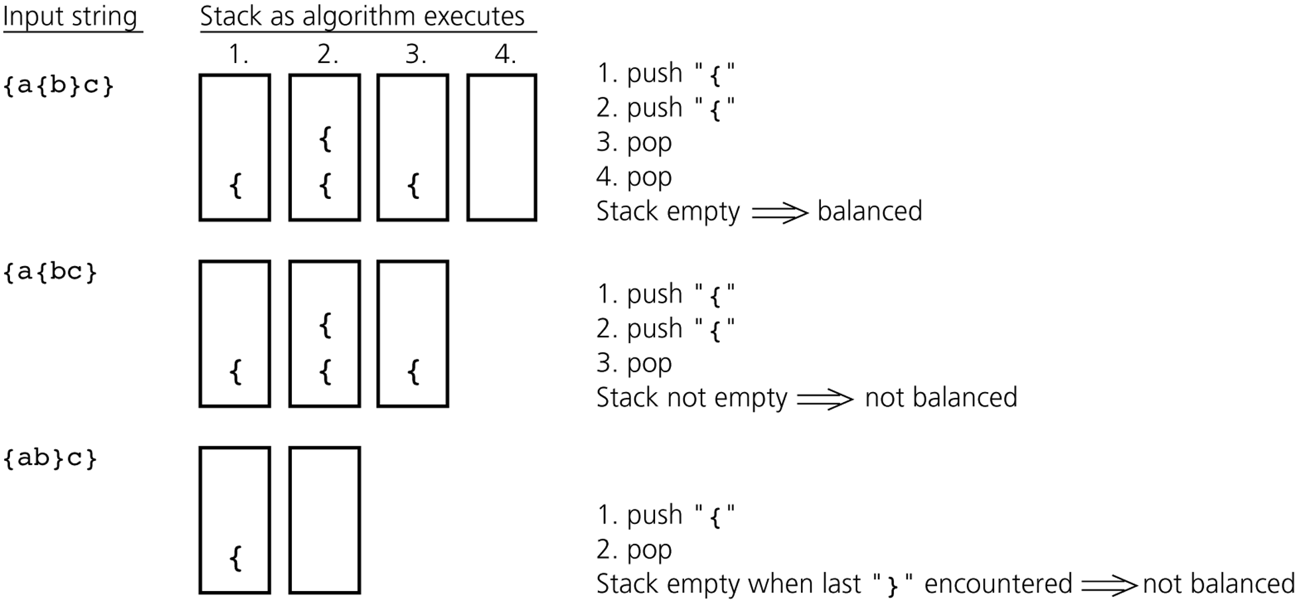
Checking for balanced braces

Slide 27
Tower of Hanoi (based on recursion)
The problem is as follows:
Given n disks of decreasing size stacked on one tower and two empty tower
It is required to stack all the disks onto third tower in decreasing order of size
The second tower may be used as temporary storage
The conditions are:
Only one disk may be moved at a time
A large disk never rest upon a smaller disk

Slide 28
Tower of Hanoi (FOR N=3 DISKS)
A
B
C
INPUT
A
B
C
OUTPUT

Slide 29
SOLUTION TO THE PROBLEM OF TOWER OF HANOI
Formula for finding the minimum number of moves to transfer ‘n’ disks from A to C is 2^{n} – 1
No of disks | No. of moves
1 | 1
2 | 3
3 | 7
4 | 15
5 | 31

Slide 30
SOLUTION TO THE PROBLEM OF TOWER OF HANOI
The solution to the Tower of Hanoi problem may be reduced to the following sub problems:
  Move the top n-1 disks from A(Beg) → B(Aux)
  Move the top disk from A(Beg) → C(End.)
  Move the top n-1 disk B(Aux) → C(End
A
B
C
A
B
C
A
B
C

Slide 31
Recursive Algorithm for tower of Hanoi
Tower(N, Beg, Aux, End)
Step 1: if N=1 then
Write: Beg → End
Return
Step 2: [move N-1 disks from tower Beg to tower Aux]
Call Tower(N-1, Beg, End, Aux)
Step 3: Write Beg → End
Step 4: [move N-1 disks from tower Aux to tower End]
Call Tower(N-1, Aux, Beg, End)
Step 5: Return

Slide 32
Tower of Hanoi
Move top disk from tower A to C
A
B
C
A
B
C
Input
Move top disk from tower A to B
Move top disk from tower C to B
A
B
C
A
B
C

Slide 33
Tower of Hanoi
Move top disk from tower A to C
Move top disk from tower B to A
A
B
C
A
B
C
Move top disk from tower B to C
Move top disk from tower A to C
A
B
C
A
B
C
OUTPUT

Slide 34
Movements for N=3 disks in Tower of Hanoi
Tower(3,A,B,c)
Tower(2,A,C,B)
Tower(2, B,A,C)
Tower(1,B,C,A)
A→ C (4)
Tower(1,A,B,C)
A→ B (2)
Tower(1,C,A,B)
B→ C (6)
Tower(1,A,B,C)
A→ C (1)
C→ B (3)
B→ A (5)
A→ C (7)

Slide 35
Expressions
Expression is a string of operands and operators
There are three types of expressions
  Infix expression
  Prefix expression (polish notation)
  Postfix expression(Reverse polish notation)

Slide 36
Expressions
1) Infix notation
Syntax: operand1 operator operand 2
Ex: (a + b), (a + b) * (c - d)
2) Prefix Notation
Syntax: Operator Operand 1 Operand 2
Ex: (+ a b), * (+ a b) (- c d)
3) Postfix Notation
Syntax: Operand 1 Operand 2 operator
Ex: (a b +), (a b +) (c d -) *

Slide 37
Evaluation of postfix expression
Suppose P is a arithmetic expression written in postfix notation
Step 1) Add right parenthesis at the end of expression P
Step 2) Scan P from left to right and repeat steps 3 and 4 for
each element of p until the sentinel “)” is encountered
Step 3) If an operand is encountered, put it on the stack.
Step 4) If an operator Θ is encountered, then:
(a) Remove the top element of stack, where A is the
top element and B is the next-to-top element
(b) Evaluate B Θ A
(c) Place the result of step (b) back on stack
Step 5) Set value equal to the top element on stack
Step 6) exit

Slide 38
Transforming Infix expressions into postfix expressions
Suppose Q is infix expression and P is equivalent Postfix expression
Polish(Q,P)
Step 1) Push “(” onto stack and add “)” to the end of “Q”
Step 2) Scan Q from the left to right and repeat steps 3 to 6
for each element of Q until the stack is empty
Step 3) If an operand is encountered, add it to P.
Step 4) If a left parenthesis is encountered, push it
onto stack

Slide 39
Step 5) If an operator Θ is encountered, then
(a) Repeatedly pop from stack and add to P each
operator(on the top of stack) which has the
same precedence as or higher precedence
than Θ
(b) Add Θ to stack
Step 6) If a right parenthesis is encountered, then
(a) Repeatedly pop from stack and add to P each
operator(on the top of stack) until a left
parenthesis is encountered
(b) Remove the left parenthesis.[Do not add the
left parenthesis to P]
Step 7) Exit

Slide 40
QUEUE
It is a non-primitive, linear data structure in which insertion (i.e. ENQUEUE) takes place from one end called REAR and deletion (i.e. DEQUEUE) of elements takes place from other end called FRONT.
queue
REAR
FRONT
elements
enter
elements
exit
4
3
2
1
no changes of order
Notes:
1) Queue is FIFO (First In First Out) structure and physically can be implemented as an array or as a linked list.
2) Queue, when implemented as an array is functionally same as any other array except that here, adding an element and deletion is done from the one direction and deletion from other just like any queue of peoples.
3) Queues have two ends:
Elements are added at one end Called REAR.
Elements are removed from the other end Called FRONT.

Slide 41
QUEUE
First element inserted in list, will be the first to be removed.
Thus, Queue is known as FIFO (First In-First Out) or FCFS (First Come First Serve).
Examples of Queue
  People waiting in Queue to purchase tickets at railway station or cinema hall,
  First person in the queue will be served first.

Slide 42
Representation of Queue
It has two pointer variables
  FRONT : Points to be element to be deleted
  REAR : Points to newly inserted element
  When queue is empty
  FRONT = -1 and REAR = -1
  When queue is not empty
Rear
A
B
C
D
Front

Slide 43
Representation of Queue
Enqueue:
A
B
C
Front
Rear
A
B
C
D
Add element
Front
Rear

Slide 44
Representation of Queue
Dequeue:
A
B
C
D
Front
Rear
Remove
A
B
C
D
Front
Rear

Slide 45
Representation of Queue
Implementation Data Structure
Array
Stack
Linked List
Operations on Queue
IsEmpty()
IsFull()
Enqeue()
Dequeue()
Types of Queue
Linear Queue
Circular Queue
Deque
Priority Queue

Slide 46
ADT of Queue
Implementation Data Structure
Array
or
Stack
or
Linked List
Operations on Queue
IsEmpty()
IsFull()
Enqeue()
Dequeue()

Slide 47
Linear Queue
It is like a straight line in which all elements stand one behind the other.
It has a definite beginning and a definite end.

Slide 48
Status of Linear Queue after some operations
(Example)
A Queue of N=5 elements:
Empty Queue
Enqueue(10)
Enqueue(20)
Enqueue(30)
Enqueue(40)
Enqueue(50)
Dequeue()
0
1
2
3
4
=> FRONT = -1 ,REAR = -1
=> FRONT = 0 ,REAR =0
=> FRONT = 0 ,REAR =1
=> FRONT = 0 ,REAR =2
=> FRONT = 0 ,REAR =3
=> FRONT = 0 ,REAR =4
=> FRONT = 1 ,REAR =4
Enqueue(60)
➔ Since REAR = 4 (i.e. N-1)➔ Overflow

Slide 49
Operations in Linear Queue
Algorithm IsEmpty()
step1. Start
step2. if (F=-1 and R = -1) return True ➔ Queue is Empty
step3. else return False
Step4. End

Slide 50
Operations in Linear Queue
Algorithm IsFull()
step1. Start
step2. if R = N-1 return True ➔ Queue is Full
step3. else return False
Step4. End

Slide 51
Operations in Linear Queue
Algorithm EnQueue(value)
Step 1: start
Step2: [check for queue is over flow or not] ➔ operation Validation
    If (R=N-1)
      Print “queue is overflow”
      go to step 5
else go to step 3
Step 3: [check condition] ➔ If it is First Element of Queue
If(R=-1) R:=F:=0
else R:=R+1
Step 4:[insert item into Queue] ➔ insert Element
QUEUE[R]:=value
Step 5:end

Slide 52
Operations in Linear Queue
Algorithm DeQueue()
Step 1: start
Step2: [check for queue is under flow or not] ➔ operation Validation
    If (F = -1)
      Print “queue is underflow”
      go to step 5
else go to step 3
Step 3: [Copy item From Queue]
X:= QUEUE[F]
Step 4:[check condition] ➔ It is only Element of Queue or not
If(F=R) F := R := -1 ➔ Empty Queue
Else F:=F+1
Step 5:end

Slide 53
Possible Values for Front F and Rear R in Linear Queue
Assume Queue of Size of N Elements (i.e. Q[0…. N-1] ).
F = -1 and R= -1 ➔ Empty Q
F= 0 and R =0 ➔ only one element present in the Q
F = R != -1 ➔ only one element present in the Q
F=0 and R=N-1 ➔ Q is Full
R= N-1 ➔ Q is Full
R= N-1 ➔ F € (0 to N-1) ➔ Q is Full
Note1: R= N-1 ➔ F € (1 to N-1) ➔ Q is full even it has space to store more elements ➔ i.e. Disadvantage of Linear Queue
Note2: [F= -1 and R € (0 to N-1) ]OR [F € (0 to N-1) and R=N-1] ➔ impossible Case.
That means Both pointers F and R Either will be inside or Out side of Queue
No further Enqueue Operation till
R= N-1

Slide 54
Drawback of Linear Queue
Once the queue is full, even though few elements from the front are deleted and some occupied space is relieved, it is not possible to add anymore new elements, as the rear has already reached the Queue’s rear most position.

Slide 55
To Overcome From the Drawback of Linear, Move to the Circular Queue

Slide 56
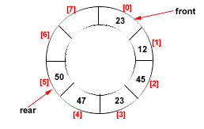
Circular Queue
A circular queue has a circular structure.
The last element of this queue is connected with the first element.
Circular Queue
Figure: Circular Queue having
Rear = 5 and Front = 0

Slide 57
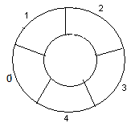
Example: circular queue with N = 5.
1. Initially, Rear = -1, Front = -1
4. Enqueue(20), Rear = 2, Front = 0.
Rear
10
20
Front
5
2. Enqueue(5),
5.Enqueue(50), Rear = 3, Front = 0.
Rear = 0, Front = 0
10
20
Rear
5
5
Front
Front
50
Rear
3.Enqueue(10), Rear = 1, Front = 0
6.Enqueue(6), Rear = 4, Front = 0
Rear
10
10
20
Front
5
5
Front
50
6
Rear

Slide 58
Example: circular queue with N = 5. Contd….
7. Enqueue(8), As Front =0 and
Rear= 4 = N-1 so Queue overflow.
8. Dequeue() , Rear = 4, Front = 1.
10
20
Front
10
20
Front
5
50
6
50
6
Rear
Rear
9.Enqueue(4), Rear = 0, Front = 1
10. Enqueue(9) As Front = Rear + 1,
so Queue overflow.
Front
20
10
Front
20
10
4
50
Rear
4
Rear
50
6
6
11. Dequeue(), Rear = 0, Front = 2
12.Dequeue(), Rear = 0, Front =3
Front
20
4
4
Rear
50
Rear
50
6
6
Front

Slide 59
Example: circular queue with N = 5. Contd….
13. Dequeue, Rear = 0, Front = 4
4
Rear
6
Front
14. Dequeue, Rear = 0, Front = 0
Rear
4
Front
as Queue is not empty and contains only one element
So updated Rear = -1, Front = -1
15. Dequeue(),
→ Queue is Empty

Slide 60
Operations in Circular Queue
Algorithm IsEmpty()
step1. Start
step2. if (F=-1 and R = -1) return True ➔ Queue is Empty
step3. else return False
Step4. End
Notes:
True → 1
False→ 0

Slide 61
Operations in Circular Queue
Algorithm IsFull()
step1. Start
step2. if ((F=0 and R = N-1) or (F:=R+1)) ➔ Queue is Full
return True
step3. else return False
Step4. End
Notes:
((F=0 and R = N-1) or (F=R+1)) === (F=R+1)%N N is Size of Queue

Slide 62
Operations in Circular Queue
Algorithm EnQueue(value)
Step 1: start
Step2: [check for queue is over flow or not] ➔ operation Validation
    If ((F=0 and R = N-1) or (F:=R+1))
      Print “queue is overflow”
      go to step 5
else go to step 3
Step 3: [insert item into Queue] ➔ Get the position where to insert Element
If(R=-1) R:=F:=0
else R:=(R+1)%N
Step 4: QUEUE[R]:=value
Step 5:end
Notes:
R=(R+1)%N === (if (R=N-1) then R =0; else R=R+1;)

Slide 63
Operations in Circular Queue
Algorithm DeQueue()
Step 1: start
Step2: [check for queue is under flow or not] ➔ operation Validation
    If (F = -1)
      Print “queue is underflow”
      go to step 5
else go to step 3
Step 3: [Copy item From Queue]
X:= QUEUE[F]
Step 4:[check condition] ➔ It is only Element of Queue or not
If(F=R) F := R := -1 ➔ Empty Queue
Else F:=(F+1)%N
Step 5:end
Notes:
F=(F+1)%N === (if (F=N-1) then F =0; else F=F+1;)

Slide 64
Queue Applications
Real life examples
  Waiting in line
  Waiting on hold for tech support
Applications related to Computer Science
  Round robin scheduling
  An electronic mailbox is a queue
  The ordering is chronological (by arrival time)
  Job scheduling (FIFO Scheduling)
  Key board buffer

Slide 65
Priority Queue

Slide 66
Priority Queue
A Priority Queue – a different kind of queue.
Similar to a regular queue:
  insert to rear
  Delete from front
  But
Elements in priority queue are ordered by some key
Element with the lowest/highest key is always at the front from where they are Deleted.
Then Elements ‘Inserted’ in ‘Proper’ position
Idea behind the Priority Queue:
  Is a queue .
  But the items are ordered by a key.
  Implies your ‘position’ in the queue may be changed by the arrival of a new item.

Slide 67
Applications of Priority Queues
Scheduling queues for a processor
Print Queues
Transmit Queues, etc.….
This means Required item for process will be in the front of queue which obtained via a dequeue() operation.
Note: a priority queue is no longer FIFO.
Because Deletion is still from front of queue, but insertions Depends on priority.

Slide 68
Priority Queues
Operations performed on priority queues
  Find an element,
  Insert a new element
  Delete an element, etc.
Two kinds of (Min, Max) priority queues exist:
In a Min priority queue, find/delete operation finds/deletes the element with minimum priority
In a Max priority queue, find/delete operation finds/deletes the element with maximum priority
Two or more elements can have the same priority

Slide 69
Double-Ended Queue

Slide 70
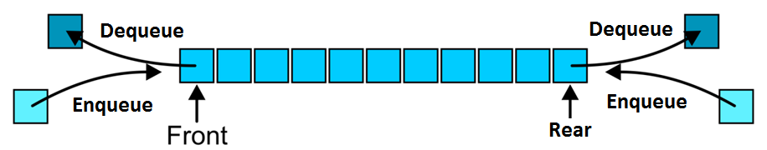
Double-Ended Queue (Deque)
A Deque or deck is a double-ended queue.
Allows elements to be added or removed on either the ends.

Slide 71
TYPES OF DEQUE
Input restricted Deque
Elements can be inserted only at one end.
Elements can be removed from both the ends.
Output restricted Deque
Elements can be removed only at one end.
Elements can be inserted from both the ends.

Slide 72
Deque as Stack and Queue
As STACK
When insertion and deletion is made at the same side.
As Queue
When items are inserted at one end and removed at the other end.

Slide 73
OPERATIONS IN DEQUE
Insert element at Rear
Insert element at Front
Delete element from Front
Delete element from Rear

Slide 74
Insert_front
insert_front() is a operation used to push an element into the front of the Deque.
insert
1 2 3 4 5 7
FRONT
REAR
0 1 2 3 4 5 7

Slide 75
Algorithm Insert_front
step1. Start
step2. Check the queue is full or not as if (r == max-1) &&(f==0)
step3. If false update the pointer f as f= f-1
step4. Insert the element at pointer f as Q[f] = element
step5. Stop

Slide 76
Insert_back
insert_back() is a operation used to push an element at the back of a Deque.
1 2 3 4 5
insert 9
FRONT
REAR
1 2 3 4 5 9

Slide 77
Alogrithm insert_back
Step1: Start
Step2: Check the queue is full or not as if (r == max-1) &&(f==0) if yes queue is full
Step3: If false update the pointer r as r= r+1
Step4: Insert the element at pointer r as Q[r] = element
Step5: Stop

Slide 78
Delete_front
remove_front() is a operation used to pop an element on front of the Deque.
Delete
1 2 3 4 5 7
FRONT
REAR
2 3 4 5 7

Slide 79
Alogrithm Delete_front
Step1: Start
Step2: Check the queue is empty or not as if (f == r and f== - 1)
if True queue is empty.
Step3: If false
element = Q[f]
Step4: If ( f== r) reset pointer f and r as f = r = -1
Else update pointer f as f = f+1
Step5: Stop

Slide 80
Remove_back
  remove_front() is a operation used to pop an element on front of the Deque.
1 2 3 4 5 7
POP
FRONT
REAR
1 2 3 4 5

Slide 81
Alogrithm Remove_back
step1. Start
step2. Check the queue is empty or not as if (f == r) if yes queue is empty
step3. If false delete element at position r as element = Q[r]
step4. Update pointer r as r = r-1
step5. If (f == r ) reset pointer f and r as f = r= -1
step6. Stop

Slide 82
Empty
It is used to test weather the Deque is empty or not.

Slide 83
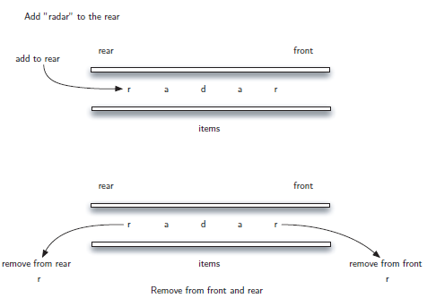
APPLICATIONS OF DEQUE
Palindrome-checker

Slide 84
APPLICATIONS OF DEQUE
A-Steal job scheduling algorithm
The A-Steal algorithm implements task scheduling for several processors(multiprocessor scheduling).
The processor gets the ﬁrst element from the deque.
When one of the processor completes execution of its own threads it can steal a thread from another processor.
It gets the last element from the deque of another processor and executes it.

Slide 85
OTHER APPLICATIONS OF DEQUE
Undo-Redo operations in Software applications.

Slide 86
Thank You

